Slide 1


Slide 2
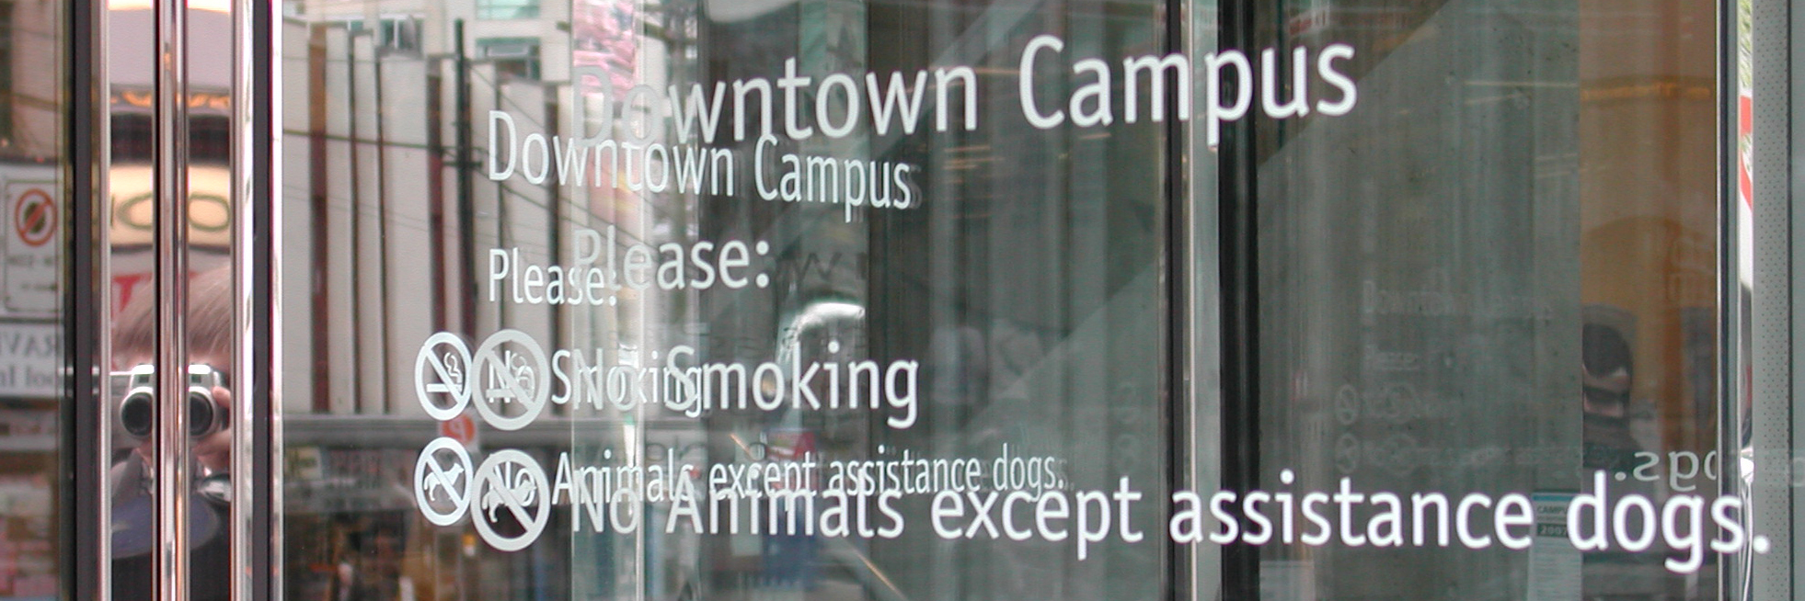

Team 3 Members >>
Evangeline Moreno (A00661772)
EXERCISE 1 – ANALYSIS
James Shen (A00680348)
Gary Armstrong (A00192781)
Ken Bayfield (A00579974)

Slide 3
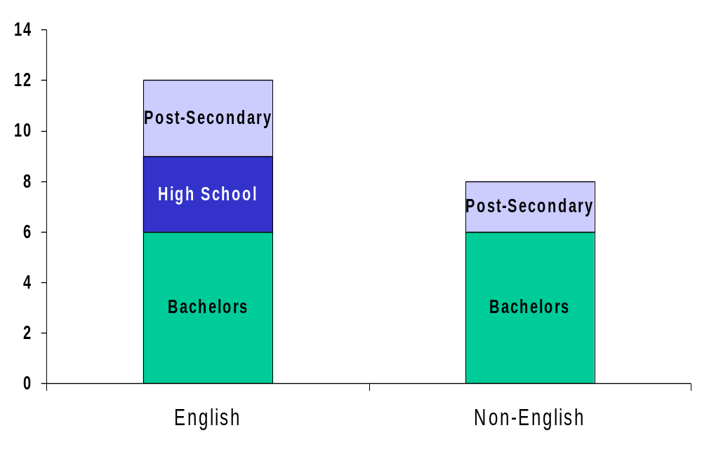
Current Education of students from English
And non-English backgrounds
Extra Notes:
About even Distribution
Most non-English from Asia

Slide 4
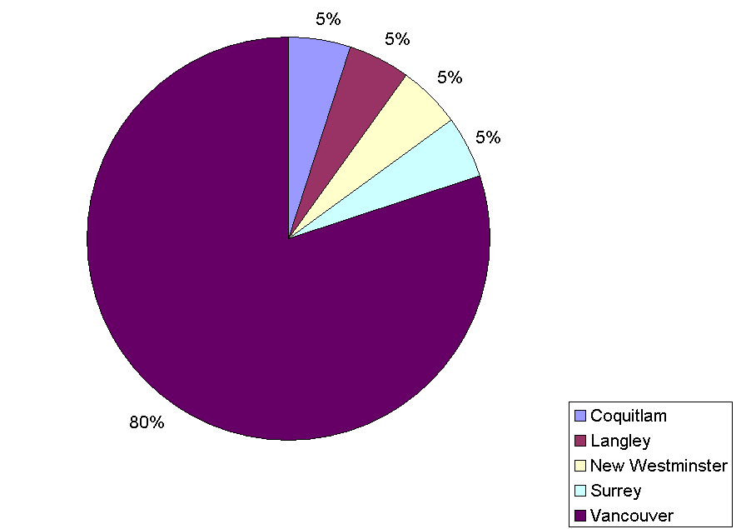
Where Do We Live?

Slide 5
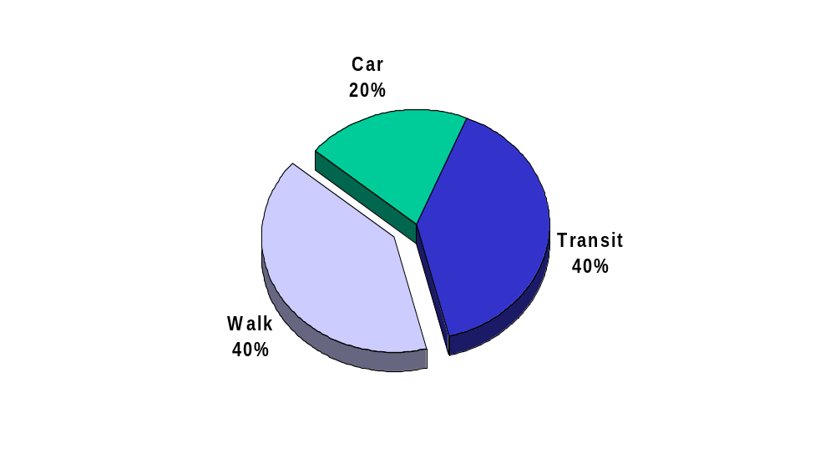
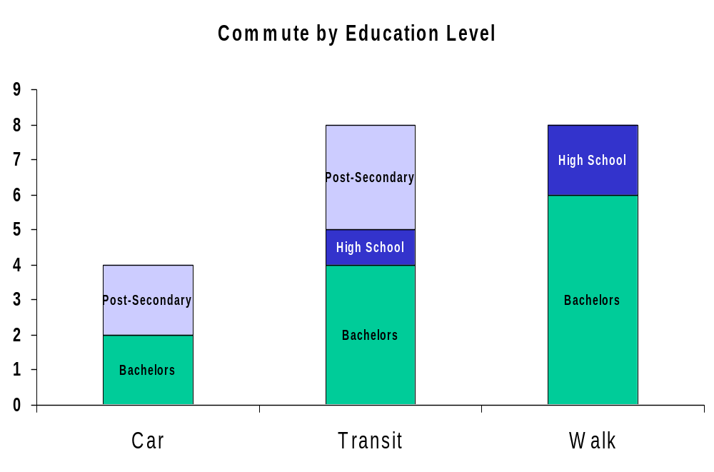
How Do We Get Here?
Of those that walk, most of them have a Bachelor’s degree.

Slide 6
Interesting Statistics
80% of students walk or take transit to school
  Of those that walk, 75% have a Ba.
  They likely live downtown…
25%-30% use Skytrain as part of their trip
  Not surprising, given proximity to Station
It appears to be a healthy class…

Slide 7
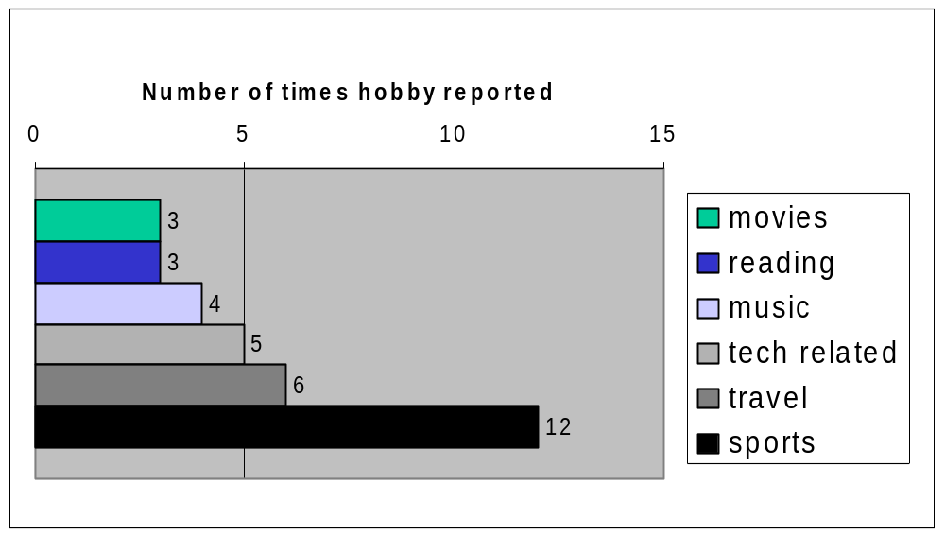
What do we like to do?
note: each person can report multiple hobbies

Slide 8
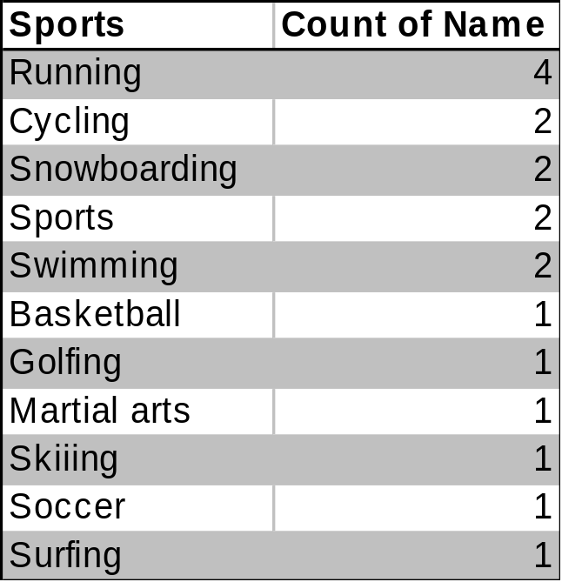
What do we like to play?

Slide 9
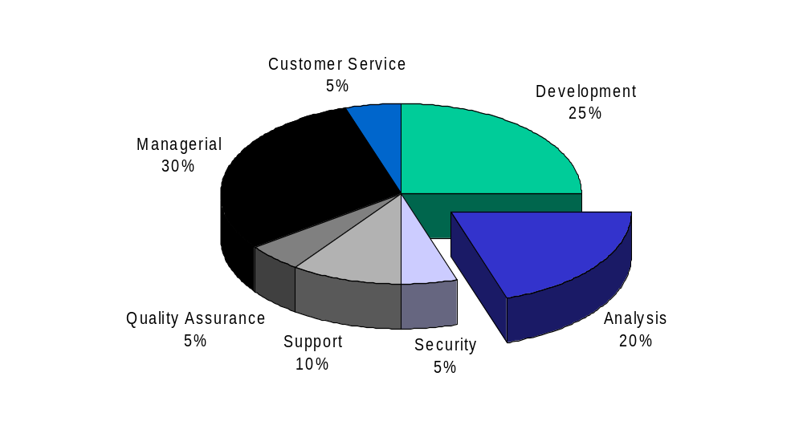
Where do we work?

Slide 10

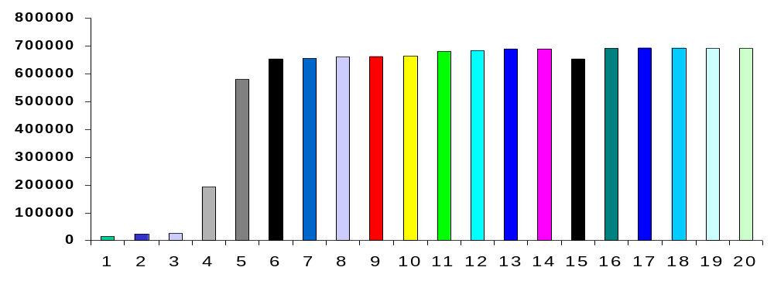
Random Fact
Assuming BCIT issues Student Numbers sequentially, 20% of the class are long-time BCIT Students (< A00200000), while the majority have likely been students of BCIT for only a few years. (>A00550000)

Slide 11
Conclusions
Most students:
  Have a university education
  Probably enjoy an Active Lifestyle
  May be taking COMP2615 as a change of direction to their current career path

